Slide 1
The Rise of Business Risk in Banking: Implications for Nordea
A Scenario Analysis for the Board of Directors
Notes:
"Good morning, esteemed members of the board. Today, we'll be discussing the rise of business risk in banking and its implications for Nordea. Our focus will be on a scenario analysis that highlights potential challenges and opportunities for our institution."

Slide 2
Introduction to Business Risk
• Definition of business risk in banking
• Shift from traditional banking risks to new business risks
• Importance of addressing these risks for Nordea's future
Notes:
"Business risk in banking refers to the potential for losses due to changes in the competitive environment. We're witnessing a shift from traditional banking risks to new business risks driven by technological advancements and changing customer expectations. It's crucial for Nordea to address these risks to secure our future in the evolving financial landscape."

Slide 3
Scenario: Apple's Financial Super App
• Hypothetical scenario: Apple launches a comprehensive financial services app
• Features: Payments, investments, loans, and banking services
• Leverages Apple's brand, user base, and technological prowess
Notes:
"Let's consider a hypothetical scenario where Apple launches a comprehensive financial services app. This app would offer payments, investments, loans, and banking services, leveraging Apple's strong brand, vast user base, and technological expertise. Such a move could significantly disrupt the banking sector, particularly in tech-savvy markets like the Nordics."

Slide 4
Threat to Nordea's Business Model
• Potential loss of market share in Nordic countries
• Erosion of customer base, especially younger demographics
• Challenge to Nordea's digital banking initiatives
Notes:
"This scenario poses several threats to Nordea's business model. We could face a potential loss of market share in Nordic countries, particularly among younger demographics who are more likely to adopt new financial technologies. This would also challenge our ongoing digital banking initiatives, potentially rendering some of our efforts less effective."

Slide 5

Impact on Nordea's Efficiency Ratios
• Potential increase in cost-to-income ratio
• Comparison: Nordea's current ratio vs. Apple's projected ratio
• Need for significant cost-cutting or revenue growth to remain competitive
Notes:
"The entry of a tech giant like Apple into banking could lead to an increase in our cost-to-income ratio. Apple's projected efficiency ratios could be significantly lower than Nordea's current figures, thanks to their advanced technology and lean operations. To remain competitive, we may need to implement significant cost-cutting measures or find new revenue streams."

Slide 6

Effect on Credit Risk
• Potential loss of prime customers to Apple's offering
• Increase in non-performing loans ratio
• Impact on Nordea's credit risk models and provisioning
Notes:
"This scenario could also affect our credit risk profile. We might lose prime customers to Apple's offering, potentially leading to an increase in our non-performing loans ratio. This shift would impact our credit risk models and provisioning strategies, requiring careful recalibration."

Slide 7
Liquidity Risk Considerations
• Possible outflow of deposits to Apple's platform
• Stress on Nordea's liquidity coverage ratio (LCR)
• Need for more expensive funding sources
Notes:
"On the liquidity front, we could face a possible outflow of deposits to Apple's platform. This would put stress on our liquidity coverage ratio (LCR) and might necessitate turning to more expensive funding sources to maintain our liquidity position."

Slide 8
Regulatory Capital Implications
• Potential decrease in return on equity (ROE)
• Pressure on capital adequacy ratios
• Need for balance sheet optimization or capital raising
Notes:
"From a regulatory capital perspective, we could see a potential decrease in our return on equity (ROE) and increased pressure on our capital adequacy ratios. To address this, we might need to optimize our balance sheet or consider raising additional capital."

Slide 9
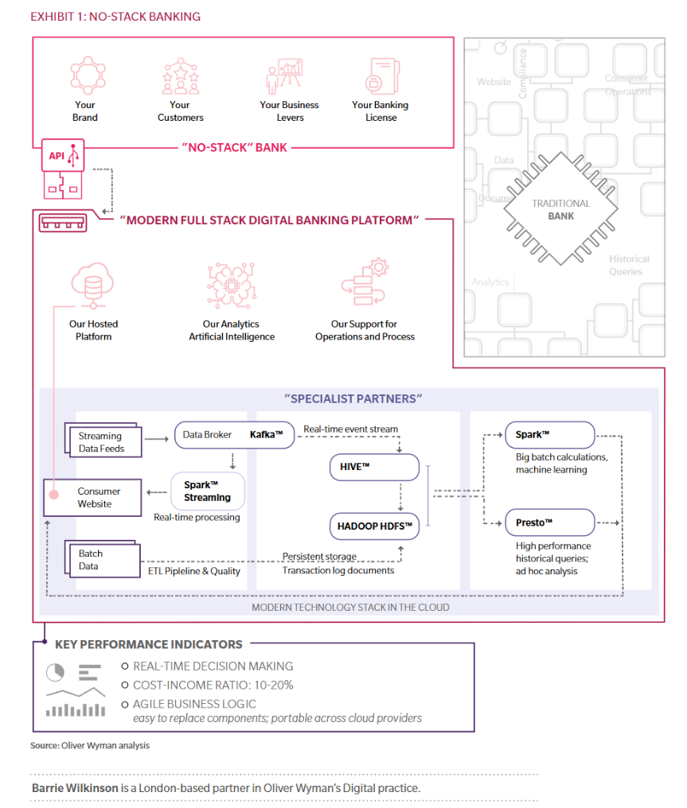
Strategic Responses
• Invest in advanced data analytics and AI for personalized services
• Explore partnerships with fintech companies
• Consider a "no-stack banking" model to reduce costs and increase agility
Notes:
"To counter these risks, we propose several strategic responses. First, we should invest in advanced data analytics and AI to offer more personalized services. Second, we could explore partnerships with fintech companies to enhance our technological capabilities. Lastly, we might consider adopting a 'no-stack banking' model to reduce costs and increase our agility."

Slide 10

Conclusion and Next Steps
• Summary of key risks and potential impacts
• Proposed action plan for the board to consider
• Emphasis on the need for proactive measures to address business risk
Notes:
"In conclusion, the entry of tech giants into banking poses significant risks to Nordea's business model, efficiency, credit risk profile, liquidity, and capital position. However, by taking proactive measures, we can turn these challenges into opportunities. We recommend the board consider the proposed action plan and emphasize the need for swift and decisive action to address these emerging business risks."
Share
Rewrite

